Slide 1
Demographic Characteristics and Trends in Texas and Redistricting
Senate Select Redistricting Committee
Austin, Texas
October 29, 2019

Slide 2
CENSUS 2020
Every ten years, the country conducts a census to count every person in the United States.
The next count will take place April 1, 2020.
Census counts used to reapportion the U.S. House of Representatives, determining how many seats each state gets.
Census counts also used to determine the number of electoral college votes a state gets.
Census counts used by state officials to redraw congressional and state legislative boundaries to account for population shifts.
The distribution of more than $675 billion in federal funds, grants, and support to states, counties, and communities are based on census data. These funds support schools, hospitals, roads, public works, and other vital programs.
An undercount of the Texas population of just 1% could translate to a loss of $300 million per year in federal funding for the state.

Slide 3
Population Growth and Projected Congressional Seats of Select States
 | 2010 Population | 2018 Population | Numeric Change 2010-2018 | Percent Change 2010-2018 | Projected Congressional Seats Added
United States | 308,745,538 | 327,167,434 | 18,409,329 | 6%
Texas | 25,145,561 | 28,701,845 | 3,555,731 | 14% | 3
Florida | 18,801,310 | 21,299,325 | 2,494,745 | 13% | 2
North Carolina | 9,535,483 | 10,383,620 | 847,884 | 9% | 1
Arizona | 6,392,017 | 7,171,646 | 779,358 | 12% | 1
Colorado | 5,029,196 | 5,695,564 | 666,248 | 13% | 1
Oregon | 3,831,074 | 4,190,713 | 359,638 | 9% | 1
Montana | 989,415 | 1,062,305 | 72,896 | 7% | 1
California | 37,253,956 | 39,557,045 | 2,302,522 | 6% | 0 to -1
Minnesota | 5,303,925 | 5,611,179 | 307,254 | 6% | 0 to -1
Source: U.S. Census Bureau. 2000 and 2010 Census Count, 2018 Population Estimates; Brennan Center for Justice.
Notes:
Texas is the second largest state in terms of population (2nd to CA) and area (2nd to AK). In terms of number of people, Texas’ growth exceeds that of all other states between 2010 and 2018. Texas has added over 3.5 million people between April 1, 2010 and July 1, 2018. This puts Texas on track to meet or surpass the number of people added in the last census when Texas gained 4 congressional seats. Projections from multiple sources anticipate Texas will gain 3 congressional districts after the 2020 census.

Slide 4
Linear Forecast of Census Bureau Population Estimates 2010-2018 and TDC Population Projections
Texas Senate District Target Size = 955,086 to 957,345
Source: Texas Demographic Center 2018 Population Projections; linear forecast derived by the Texas Demographic Center from Census Bureau Population Estimates
Notes:
The Texas Demographic Center produces population projections for the state. In comparing these projections, to a linear forecast of the Census Bureau’s population estimates since 2010, we see the Texas Demographic Center is closely aligned with the Census Bureau estimates trend. TDC projections indicate Texas will grow to just under 29.7 million by 2020.

Slide 5
Texas added an estimated 379,128 people between July 1, 2017 and July 1, 2018.
About 1,039 people per day added to our population.
  About 524 persons per day from natural increase (more births than deaths)
  About 515 per day from net migration (288 international and 227 domestic migrants per day).
Source: U.S. Census Bureau, 2018 Population Estimates.

Slide 6
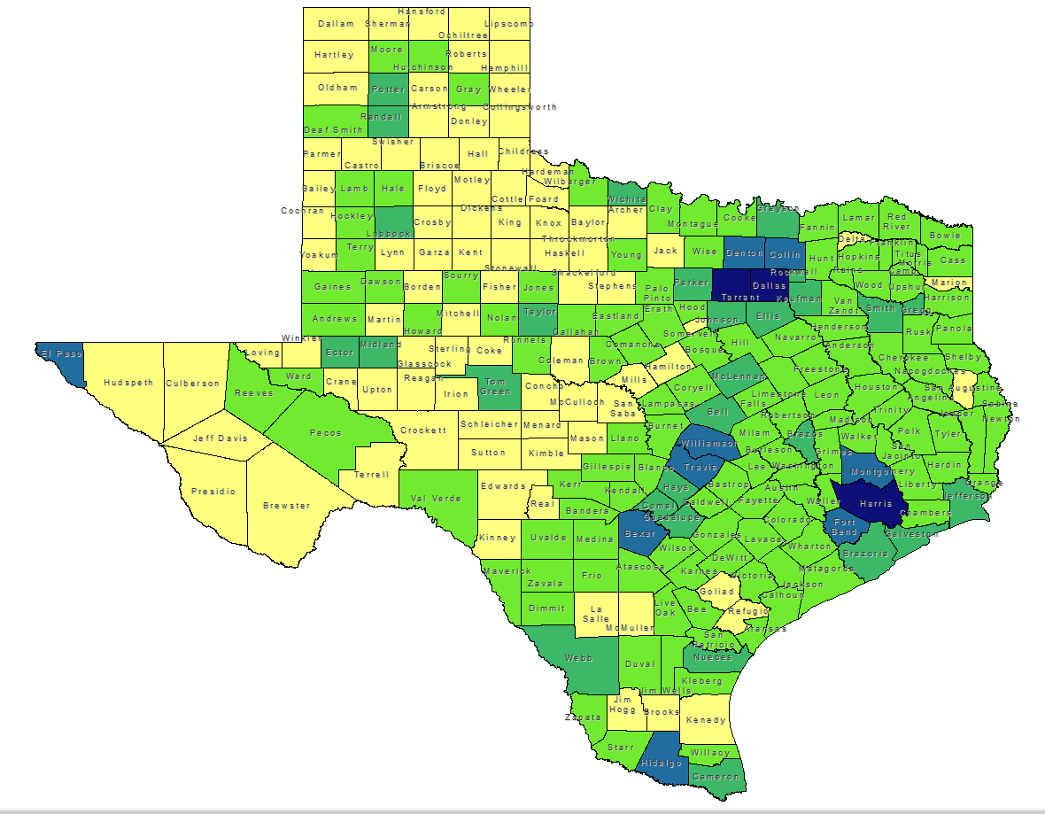
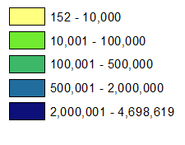


Total Estimated Population by County, Texas, 2018
78.5 % live along and between I-45 and I-35
8.5% live east of I-45 (excluding Collin and Grayson)
13% live west of I-35
0.7% live in rural counties with urban population less than 2,500 (49 counties)
10.7% in non-metropolitan counties (172 counties)
Source: U.S. Census Bureau, 2018 Vintage Population Estimates

Slide 7
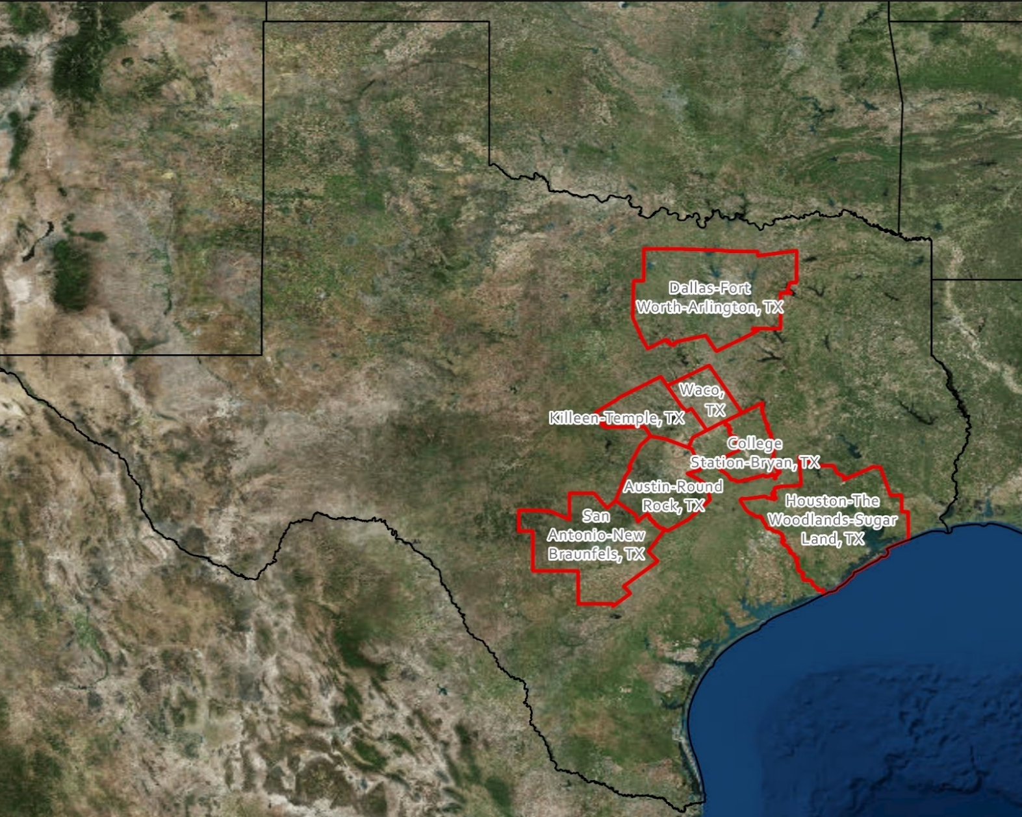
Seven Metropolitan Statistical Areas Accounted for 70% of Texas’ Population in 2017
Source: U.S. Census Bureau, 2017 Vintage Population Estimates

Slide 8
Estimated Population Change, Texas Counties,
2010 to 2018
96 counties lost population over the 8 year period.
Source: U.S. Census Bureau, 2018 Population Estimates
Notes:
Population change over the decade has been greatest in the urban and suburban population triangle counties. Counties in the lower Rio Grande Valley also had significant growth as did El Paso. Overall, 158 counties gained population while 96 (38%) lost population over the decade.

Slide 9
Estimated Percent Change of the Total Population by County, Texas, 2010 to 2018
Source: U.S. Census Bureau, 2018 Population Estimates
Notes:
Percent change is an indicator of the speed of population change void of information about the volume of population change. Percent change in the population over the past few years has been greatest in the suburban population triangle counties, notably among counties between San Antonio and Austin. In the early part of the decade, counties in the Eagle Ford Shale area (south east of San Antonio) had been growing quickly. This is less so the case today. The Cline Shale area (Midland and Odessa area) continues to grow and in some cases even growing faster than the State.

Slide 10
Top Counties for Numeric Growth in Texas, 2017-2018
County | U.S. Rank | 2018 Population Estimate | Population Change 2017-18 | Percent of Change from Natural Increase | Percent of Change from Domestic Migration | Percent of Change from International Migration
Harris | 3 | 4,698,619 | 34,460 | 122.5% | -127.2% | 104.8%
Collin | 4 | 1,005,146 | 33,753 | 19.0% | 64.7% | 16.3%
Tarrant | 8 | 2,084,931 | 27,463 | 54.2% | 15.6% | 30.2%
Bexar | 9 | 1,986,049 | 27,208 | 51.1% | 30.1% | 18.8%
Denton | 11 | 859,064 | 23,734 | 25.9% | 63.8% | 10.3%
Fort Bend | 13 | 787,858 | 21,722 | 29.0% | 45.8% | 25.2%
Travis | 14 | 1,248,743 | 20,972 | 46.3% | 23.5% | 30.2%
Williamson | 15 | 566,719 | 20,771 | 18.4% | 75.7% | 5.9%
Montgomery | 17 | 590,925 | 18,779 | 17.4% | 73.9% | 8.6%
Dallas | 28 | 2,637,772 | 14,973 | 153.5% | -148.9% | 95.5%
Hays | 56 | 222,631 | 8,354 | 18.7% | 78.3% | 3.1%
Bell | 61 | 355,642 | 7,791 | 49.1% | 39.8% | 11.1%
Hidalgo | 65 | 865,939 | 7,616 | 131.1% | -46.7% | 15.6%
Comal | 67 | 148,373 | 7,583 | 4.9% | 93.1% | 2.0%
Brazoria | 68 | 370,200 | 7,500 | 30.9% | 59.8% | 9.3%
Midland | 72 | 172,578 | 7,192 | 24.3% | 69.3% | 6.4%
Source: U.S. Census Bureau, 2018 Vintage Population Estimates
Harris, Dallas, and Hidalgo Counties had negative net migration.

Slide 11
Top Counties for Percent Growth* in Texas, 2017-2018
County | U.S. Rank | 2018 Population Estimate | Population Change 2017-18 | Percent Population Change 2017-18 | Percent of Population Change from Natural Increase | Percent of Population Change from Domestic Migration | Percent of Population Change from International Migration
Comal | 3 | 148,373 | 7,583 | 5.4% | 4.9% | 93.1% | 2.0%
Kaufman | 4 | 128,622 | 5,777 | 4.7% | 13.0% | 85.8% | 1.2%
Midland | 7 | 172,578 | 7,192 | 4.3% | 24.3% | 69.3% | 6.4%
Hood | 10 | 60,537 | 2,383 | 4.1% | -2.3% | 100.0% | 2.3%
Rockwall | 13 | 100,657 | 3,780 | 3.9% | 11.8% | 84.4% | 3.8%
Hays | 14 | 222,631 | 8,354 | 3.9% | 18.7% | 78.3% | 3.1%
Williamson | 18 | 566,719 | 20,771 | 3.8% | 18.4% | 75.7% | 5.9%
Kendall | 20 | 45,641 | 1,657 | 3.8% | 0.5% | 94.9% | 4.6%
Wise | 22 | 68,305 | 2,442 | 3.7% | 6.4% | 91.9% | 1.7%
Waller | 24 | 53,126 | 1,841 | 3.6% | 18.9% | 77.7% | 3.4%
Parker | 31 | 138,371 | 4,667 | 3.5% | 9.5% | 88.3% | 2.2%
Collin | 33 | 1,005,146 | 33,753 | 3.5% | 19.0% | 64.7% | 16.3%
Rains | 34 | 12,159 | 408 | 3.5% | -5.9% | 103.2% | 2.7%
Ellis | 39 | 179,436 | 5,800 | 3.3% | 16.0% | 81.7% | 2.3%
Montgomery | 43 | 590,925 | 18,779 | 3.3% | 17.4% | 73.9% | 8.6%
Ector | 48 | 162,124 | 4,951 | 3.2% | 29.6% | 63.9% | 6.5%
*Among Counties with 10,000 or more population in 2018
Source: U.S. Census Bureau, 2018 Vintage Population Estimates

Slide 12


Estimated Percent of Total Net-Migrant Flow for Texas and Other States, 2016
Source: Internal Revenue Service, 2018. Migration Tables, 2015-16

Slide 13
Annual Shares of Recent Non-Citizen Immigrants to Texas by World Area of Birth, 2005-2015
Estimated number of international migrants to Texas
101,588
77,702
98,194
Sources: U.S. Census Bureau, American Community Survey, 1-Year PUMS. Population estimates 2017 vintage and 2000-2010 intercensual estimates

Slide 14
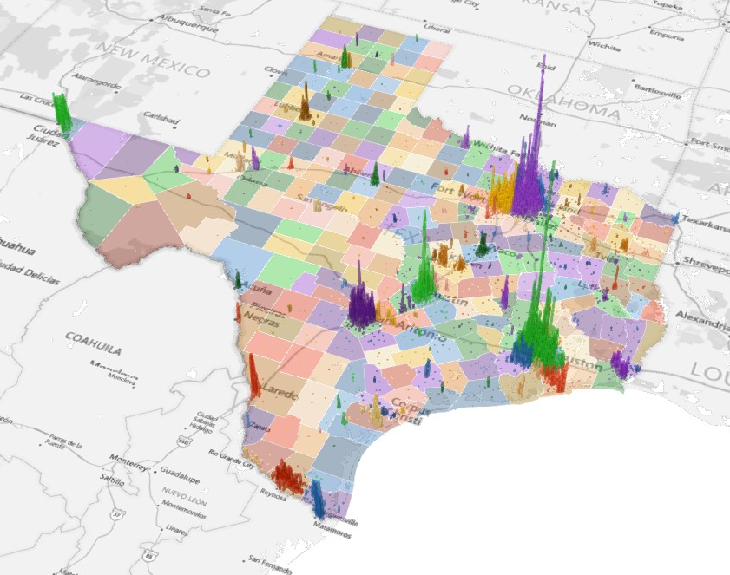
Population Density for Census Tracts, Texas, 2016
Source: U.S. Census Bureau, American Community Survey, 2012-2016 5-Year Sample

Slide 15
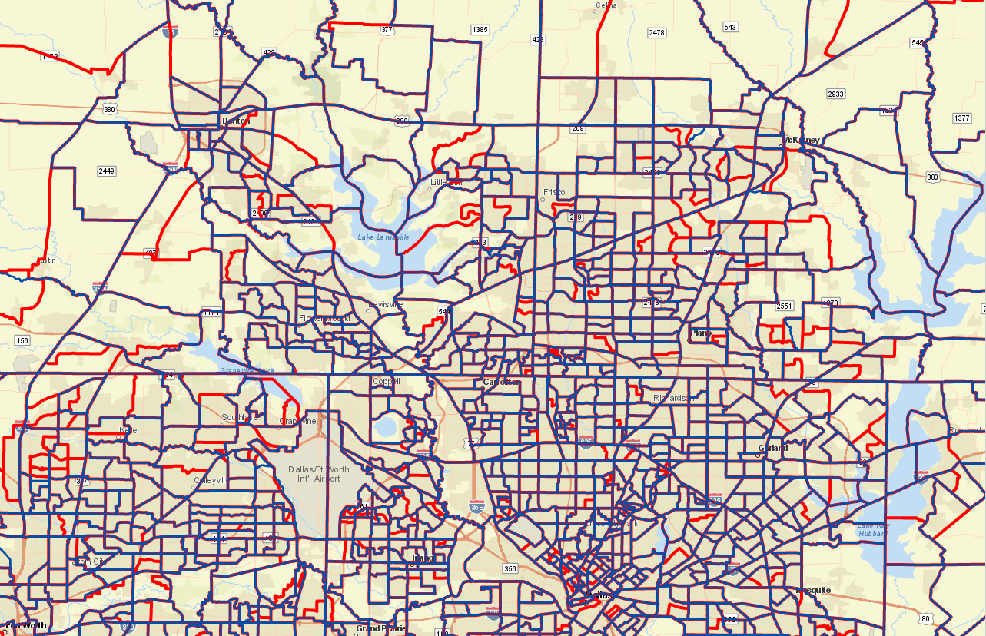
2010 census tracks (blue/purple) and proposed census track splits (red) for 2020, north Metroplex Area

Slide 16
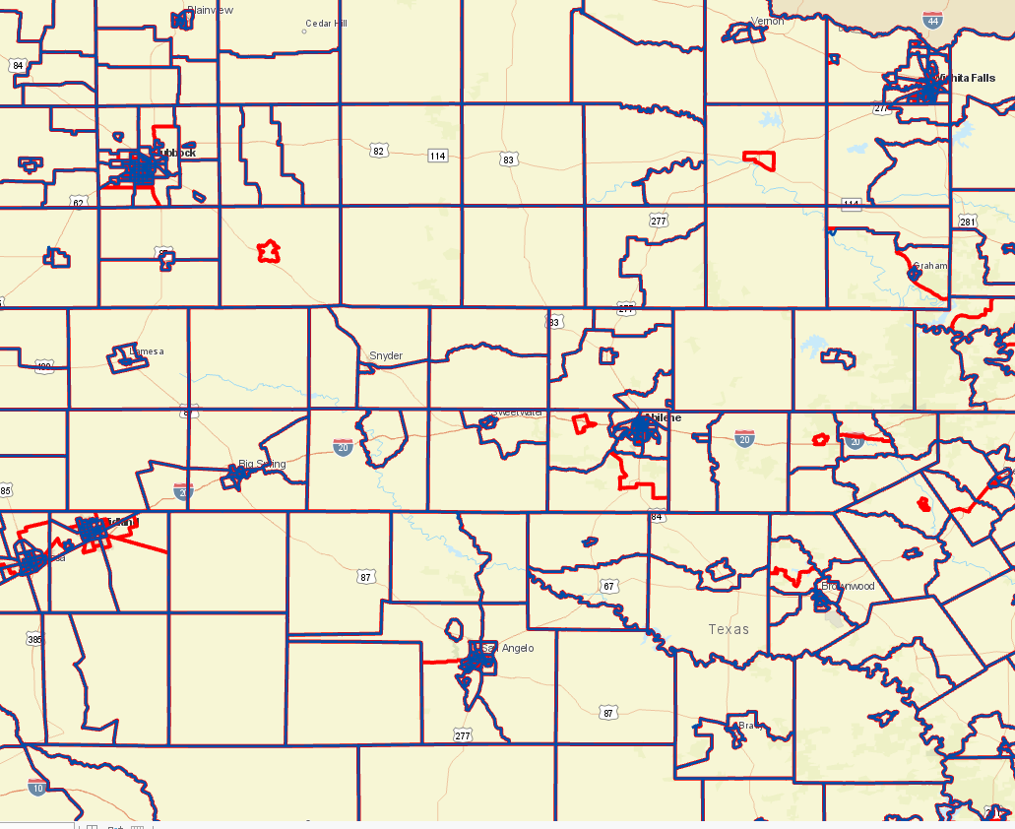
2010 census tracks (blue/purple) and proposed census track splits (red) for 2020, west Texas

Slide 17
Texas Racial and Ethnic Composition,
2010 and 2018
86.4% of Texas’ population growth has been from growth of racial and ethnic minority groups
11
Source: U.S. Census Bureau. 2018 Population Estimates
Notes:
As of the 2000 Census, about 53% of Texas’ population was non-Hispanic White, about 32% where of Hispanic descent, about 11% where non-Hispanic African American, and about 3% NH Asian, and 1% non-Hispanic Other.
In 2010, the Texas population was made up of 45% non-Hispanic Whites, 38% of Hispanic descent, 11% non-Hispanic Black or African American, 4% non-Hispanic Asian, and 2% non-Hispanic Other. In 2017, Texas continues to diversify with increases in the proportion of the population identifying as Hispanic and NH Asian and a decrease in the proportion identifying as White, NH.
Hispanics are a major driver of growth in Texas. Between 2000 and 2010, of every 10 people added to the Texas population, 6 were Hispanic. In 2010, Hispanics made up 32% of the total Texas population. Currently, Hispanics make up 39% of the total population. This represents an annual growth rate of over 2.5%, higher than the state growth rate. Over half (53.7%) of the growth add to the Texas population between 2010 and 2017 can be attributed to growth among Hispanics.

Slide 18
Percent of the population that is Asian, Texas Census Tracts, 2013-2017
Dallas-Fort Worth Houston
Source: U.S. Census Bureau, American Community Survey, 2013-2017 5-Year Sample

Slide 19
Percent of the population that is Hispanic, Texas Census Tracts, 2013-2017
Dallas-Fort Worth Houston
Source: U.S. Census Bureau, American Community Survey, 2013-2017 5-Year Sample

Slide 20
Percent of the population that is Hispanic, Texas Census Tracts, San Antonio/Austin, 2013-2017
Source: U.S. Census Bureau, American Community Survey, 2013-2017 5-Year Sample

Slide 21
Percent of the population that is Black, Texas Census Tracts, 2013-2017
Dallas-Fort Worth Houston
Source: U.S. Census Bureau, American Community Survey, 2013-2017 5-Year Sample

Slide 22
Percent of the population age 18 and older who are foreign-born, non-citizens, Texas Counties, 2013-2017
Source: U.S. Census Bureau, American Community Survey, 2013-2017 5-Year Sample

Slide 23
Percent of the population age 18 and older who are foreign-born, non-citizens, Texas Census Tracts, 2013-2017
Dallas-Fort Worth Houston
San Antonio-Austin LRGV

Slide 24
Percent of the population age 18 and older who are foreign-born, non-citizens, Texas Census Tracts, 2013-2017
El Paso
Source: U.S. Census Bureau, American Community Survey, 2013-2017 5-Year Sample

Slide 25

Contact
  State Demographer
  Texas Demographic Center
  Office: (210) 458-6530
  Email: Lloyd.Potter@UTSA.edu
  Internet: Demographics.Texas.gov
Lloyd Potter, Ph.D.
@TexasDemography
Notes:
The Texas State Demographic Center is committed to supporting government, business, non-profit organizations and citizens with the best, most accurate, and objective information we can identify about our greatest asset, the people of Texas.

